Slide 2
Objectives Overview
Discuss the evolution of the Internet
Briefly describe various broadband Internet connections
Describe the purpose of an IP address and its relationship to a domain name
Describe features of browsers and identify the components of a web address
Describe ways to compose effective search text
See Page 56
for Detailed Objectives

Slide 3
Objectives Overview
Describe uses of various types of websites
Explain how the web uses graphics, animation, audio, video, and virtual reality
Explain how email, email lists, instant messaging, chat rooms, online discussions, VoIP, and FTP work
Identify the rules of netiquette
Explain benefits and risks of using online social networks
See Page 56
for Detailed Objectives

Slide 4
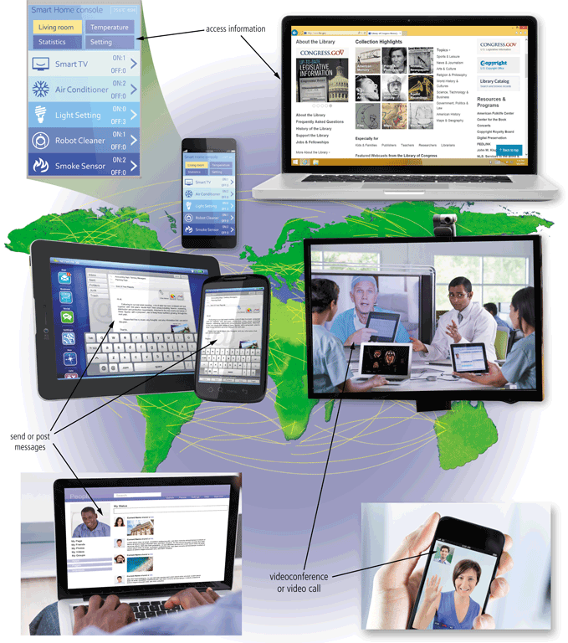
The Internet
The Internet is a worldwide collection of networks that connects millions of businesses, government agencies, educational institutions, and individuals
Pages 56 - 57
Figure 2-1

Slide 5
The Internet
The Internet originated as ARPANET in September 1969 and had two main goals:
Allow scientists at different physical locations to share information and work together
Function even if part of the network were disabled or destroyed by a disaster
Page 56

Slide 6
The Internet
1969 ARPANET becomes functional
1984 ARPANET has more than 1,000 individual computers linked as hosts
Today Millions of hosts connect to the Internet
Page 56

Slide 7
Connecting to the Internet
With wired connections, a computer or device physically attaches via a cable or wire to a communications device
Computers without a communications device can use a wireless modem or other communications device that enables wireless connectivity
Page 58

Slide 8
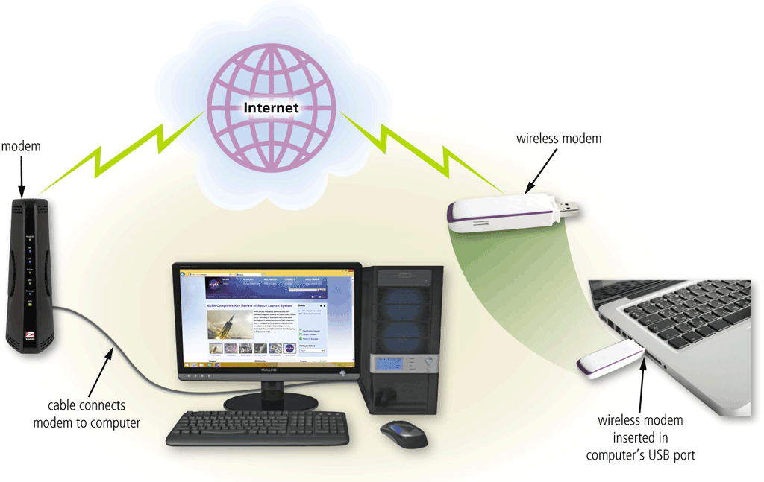
Connecting to the Internet
Page 58
Figure 2-2

Slide 9
Connecting to the Internet
Wired
Wireless
Cable Internet service
DSL (digital subscriber line)
Fiber to the Premises (FTTP)
Wi-Fi (wireless fidelity)
Mobile broadband
Fixed wireless
Satellite Internet Service
Page 59

Slide 10
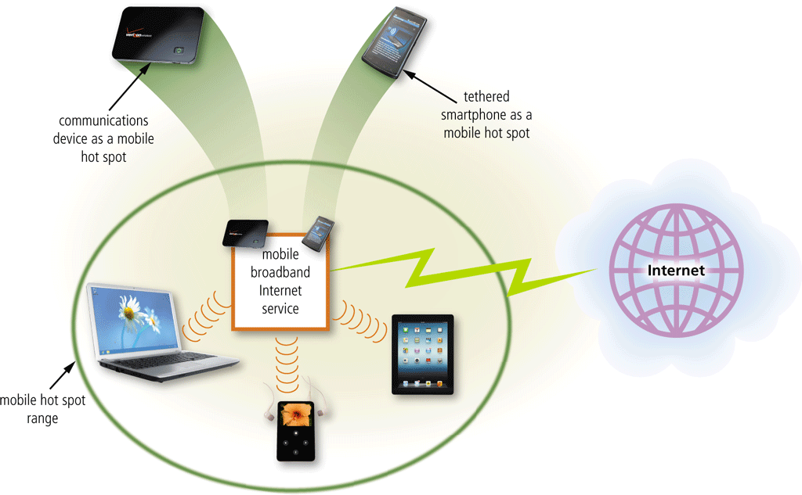
Connecting to the Internet
A hot spot is a wireless network that provides Internet connections to mobile computers and devices
Pages 59 - 60
Figure 2-3

Slide 11
Connecting to the Internet
An Internet service provider (ISP) is a business that provides individuals and organizations access to the Internet free or for a fee
Bandwidth represents the amount of data that travels over a network
Megabyte (MB)
Gigabyte (GB)
Page 58

Slide 12
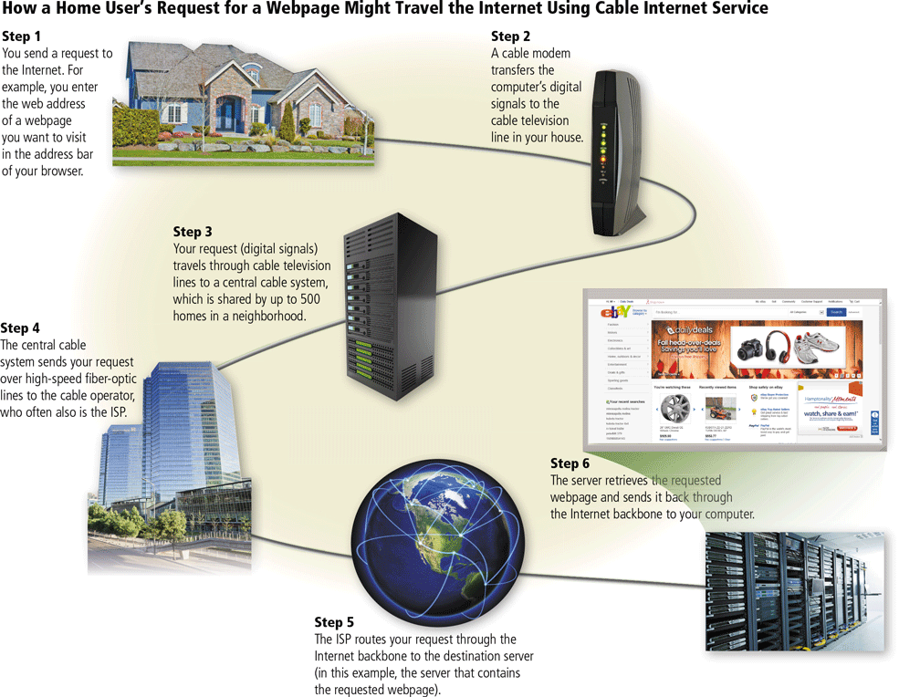
Connecting to the Internet
Page 62
Figure 2-4

Slide 13
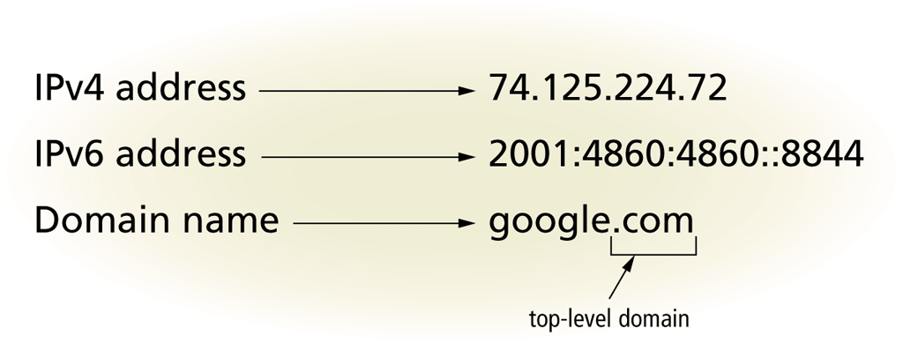
Connecting to the Internet
An IP address is a sequence of numbers that uniquely identifies each computer or device connected to the Internet
A domain name is a text-based name that corresponds to the IP address
A DNS server translates the domain name into its associated IP address
Pages 62 - 64
Figure 2-5

Slide 14
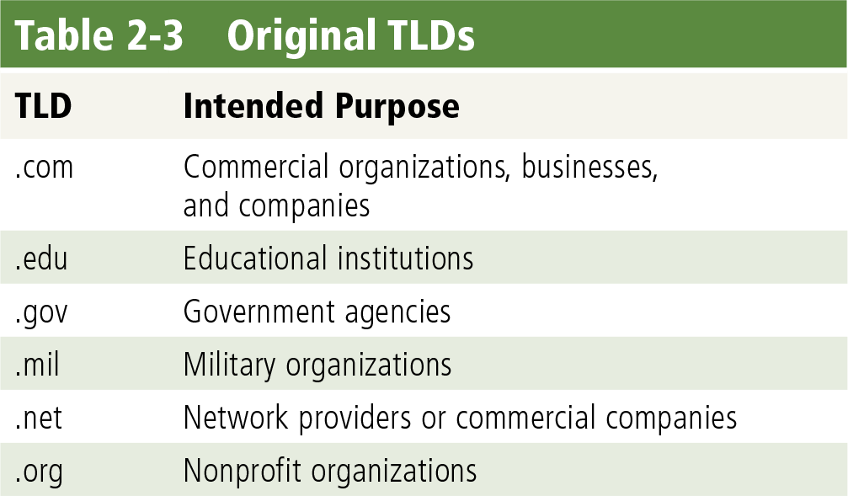
Connecting to the Internet
Page 63
Table 2-3

Slide 15
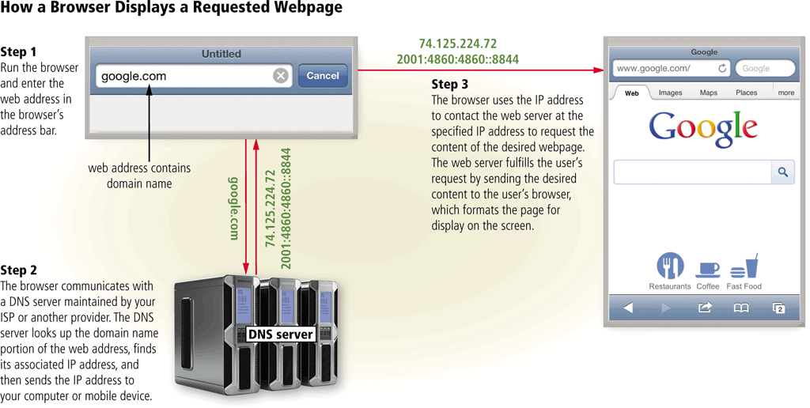
Connecting to the Internet
Page 64
Figure 2-6

Slide 16
The World Wide Web
The World Wide Web (WWW), or web, consists of a worldwide collection of electronic documents (webpages)
A website is a collection of related webpages and associated items
A web server is a computer that delivers requested webpages to your computer
Web 2.0 refers to websites that provide a means for users to share personal information, allow users to modify website content, and provide applications through a browser
Page 65

Slide 17
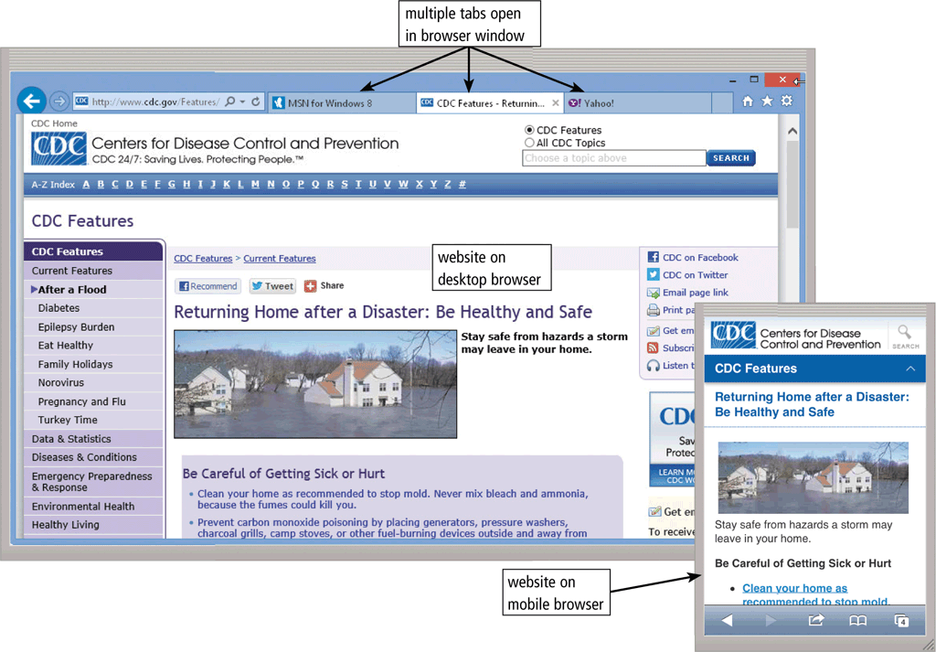
The World Wide Web
A browser is an application that enables users with an Internet connection to access and view webpages on a computer or mobile device
A home page is the first page that a website displays
Current browsers typically support tabbed browsing
Pages 65 - 66
Figure 2-7

Slide 18
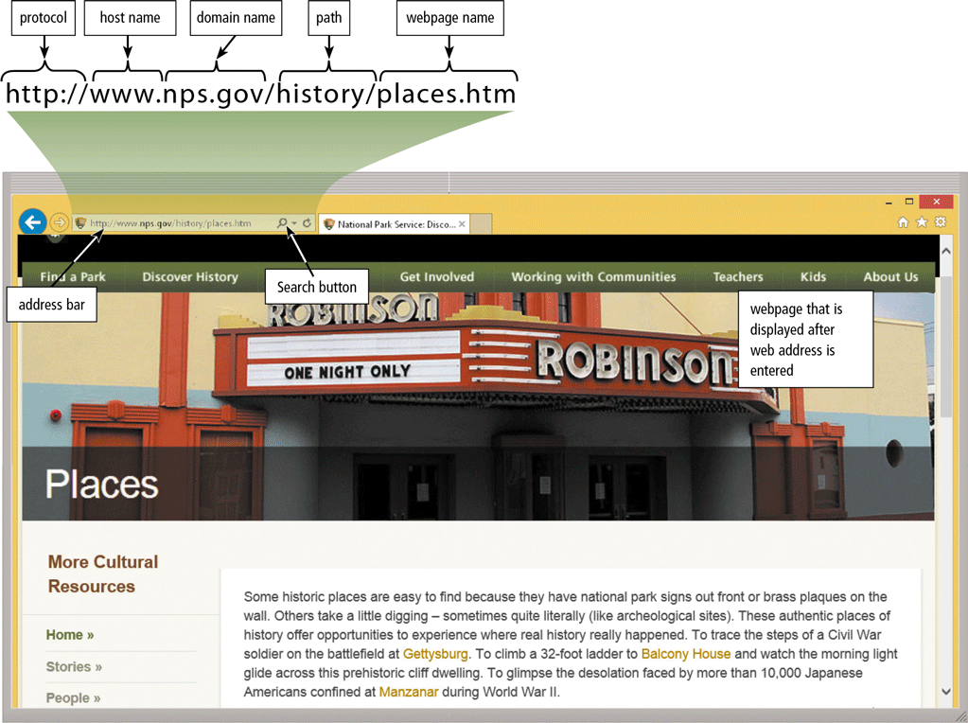
The World Wide Web
A webpage has a unique address, called a web address or URL
Page 68
Figure 2-8

Slide 19
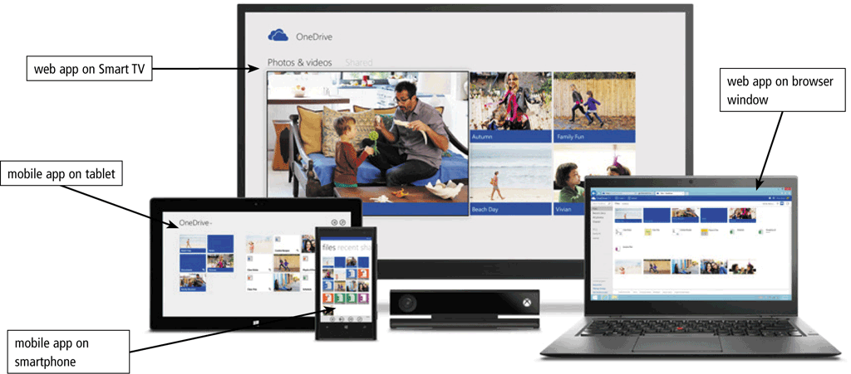
The World Wide Web
A web app is an application stored on a web server that you access through a browser
Web app hosts usually provide storage for users’ data and information on their servers, known as cloud storage
Pages 69 – 70
Figure 2-9

Slide 20
Types of Websites
A web search engine is software that finds websites, webpages, images, videos, news, maps, and other information related to a specific topic
A subject directory classifies webpages in an organized set of categories, such as sports or shopping, and related subcategories
Pages 71 - 72

Slide 21
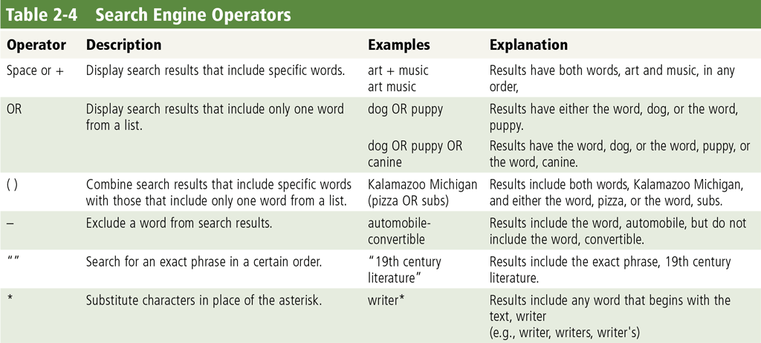
Types of Websites
Search operators can help to refine your search
Page 72
Table 2-4

Slide 22
Types of Websites
There are several types of websites
Search engine
Online social network
Informational and research
Media sharing
Bookmarking
News, weather, sports, and other mass media
Pages 71 – 76

Slide 23
Types of Websites
Educational
Business, governmental, and organizational
Blogs
Wiki and collaboration
Health and fitness
Science
Pages 77 – 79

Slide 24
Types of Websites
Entertainment
Banking and finance
Travel and tourism
Mapping
Retail and auctions
Pages 79 – 82

Slide 25
Types of Websites
Careers and employment
E-commerce
Portals
Content aggregation
Website creation and management
Pages 82 – 84

Slide 26
Types of Websites
Web publishing is the creation and maintenance of websites
Plan the website
Design the website
Create the website
Host the website
Maintain the website
Page 84

Slide 27
Digital Media on the Web
Multimedia refers to any application that combines text with media
Graphics
Animation
Audio
Video
Virtual Reality
Page 85

Slide 28
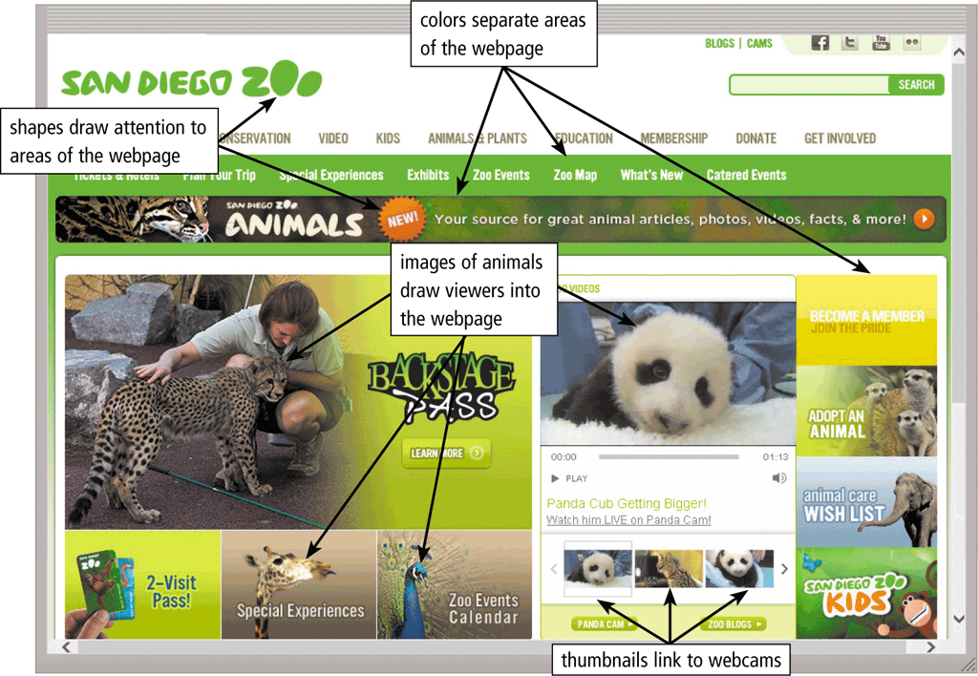
Digital Media on the Web
A graphic is a visual representation of nontext information
Graphic formats include BMP, GIF, JPEG, PNG, and TIFF
Pages 85 – 86
Figure 2-22

Slide 29

Digital Media on the Web
An infographic is a visual representation of data and information, designed to communicate quickly, simplify complex concepts, or present patterns or trends
Page 86
Figure 2-23

Slide 30
Digital Media on the Web
Animation is the appearance of motion created by displaying a series of still images in sequence
Page 86

Slide 31
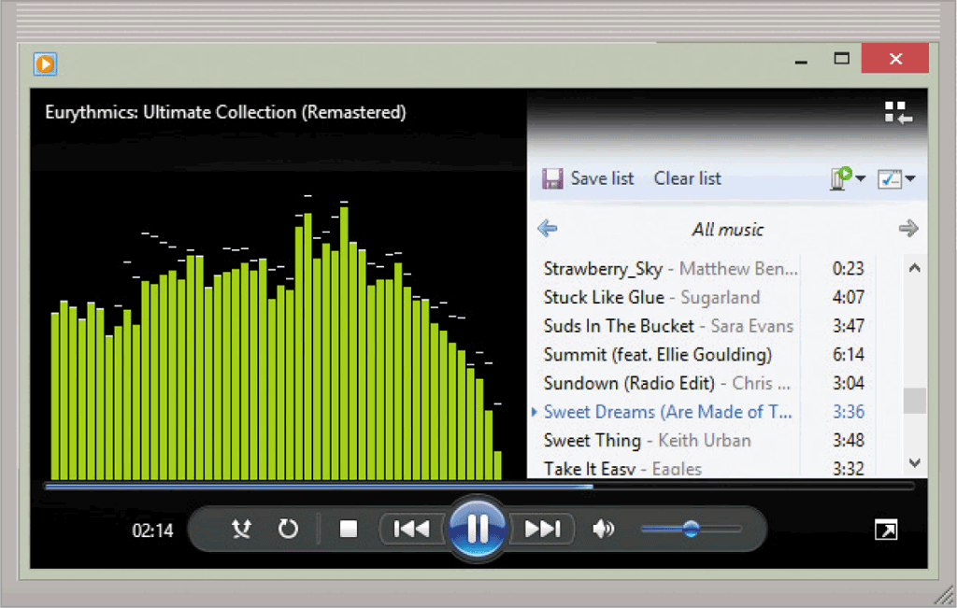
Digital Media on the Web
Audio includes music, speech, or any other sound
Compressed to reduce file size
You listen to audio on your computer using a media player
Pages 86 - 87
Figure 2-24

Slide 32
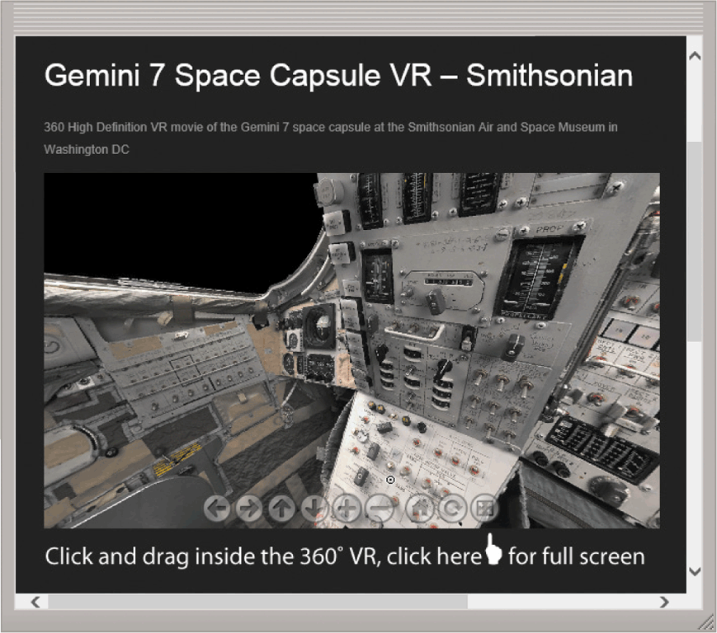
Digital Media on the Web
Video consists of images displayed in motion
Virtual reality (VR) is the use of computers to simulate a real or imagined environment that appears as a three-dimensional space
Pages 87 - 88
Figure 2-25

Slide 33
Digital Media on the Web
A plug-in, or add-on, is a program that extends the capability of a browser
Page 88

Slide 34
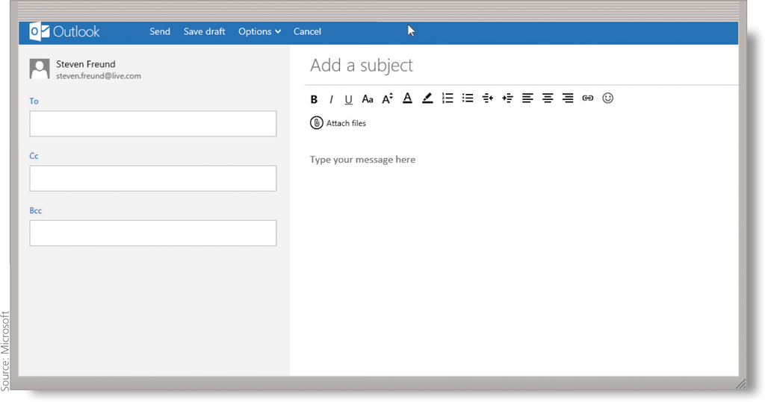
Other Internet Services
Email is the transmission of messages and files via a computer network
An email program allows you to create, send, receive, forward, store, print, and delete email messages
Page 88

Slide 35
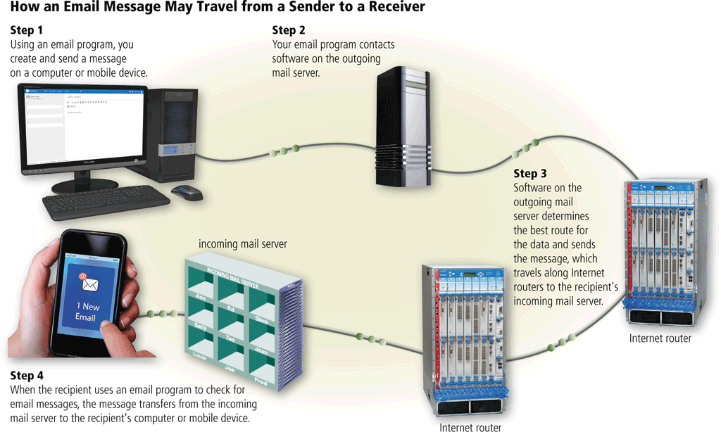
Other Internet Services
Page 89
Figure 2-26

Slide 36
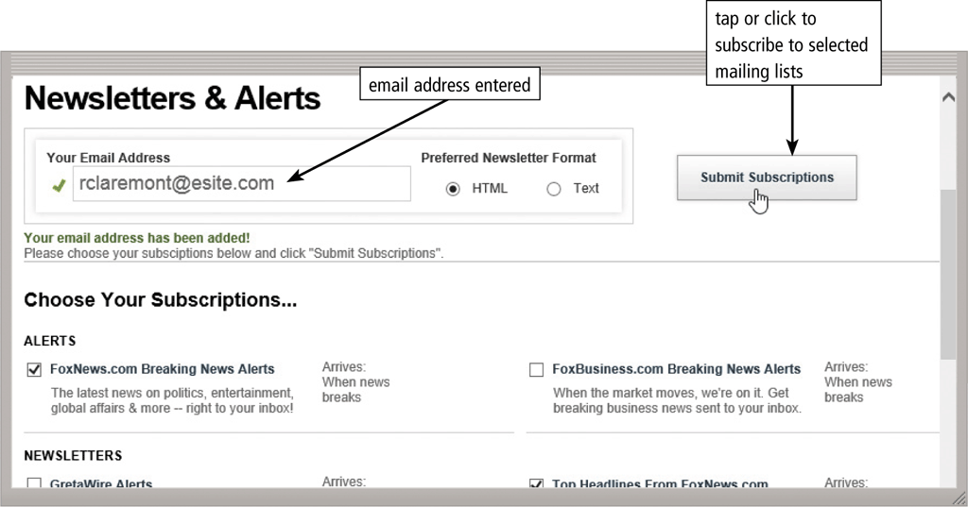
Other Internet Services
An email list is a group of email addresses used for mass distribution of a message
Page 90
Figure 2-27

Slide 37
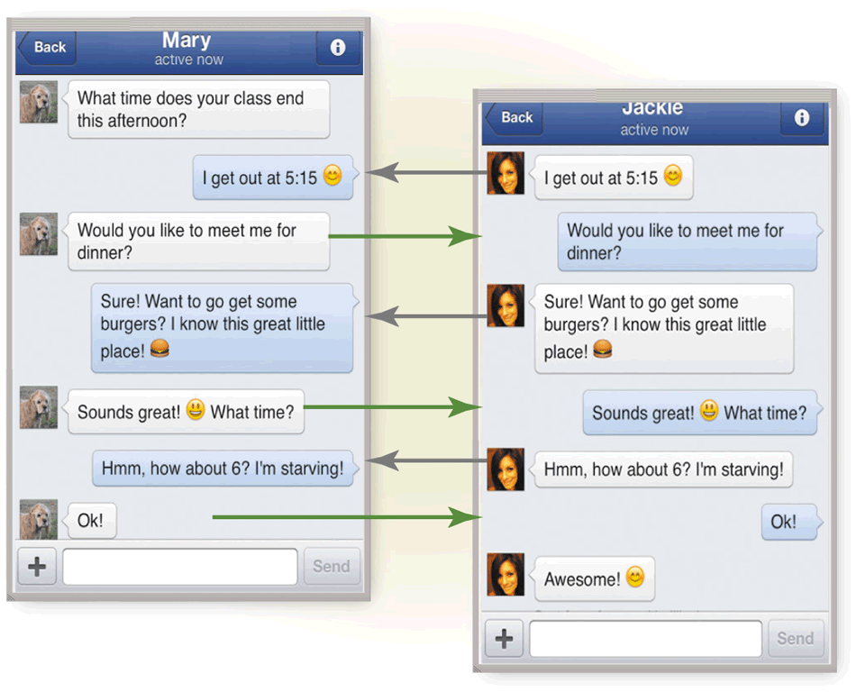
Other Internet Services
Instant messaging services notify you when one or more of your established contacts are online and then allows you to exchange messages or files or join a private chat room with them
Page 90
Figure 2-28

Slide 38
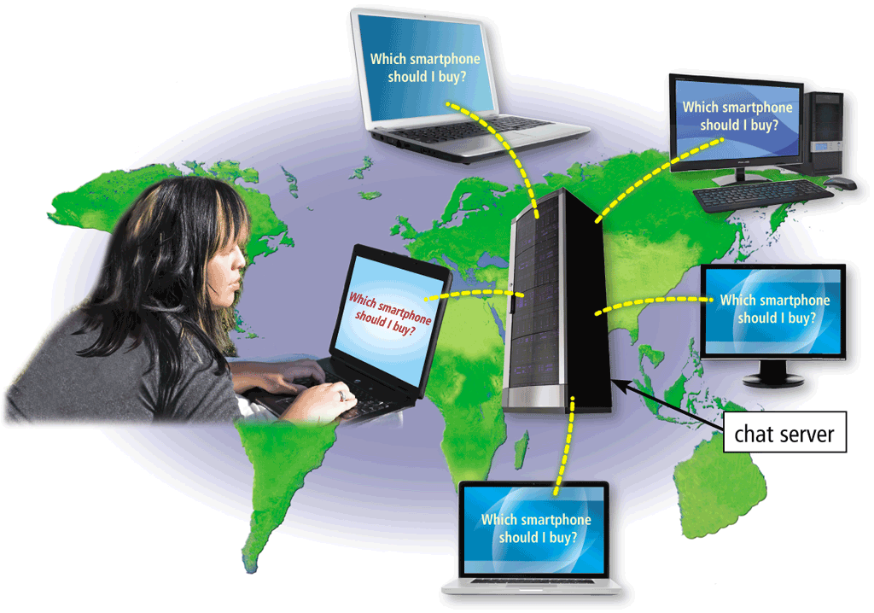
Other Internet Services
A chat is a real-time typed conversation that takes place on a computer or mobile device with many other online users
A chat room is a website or application that permits users to chat with others who are online at the same time
Page 91
Figure 2-29

Slide 39
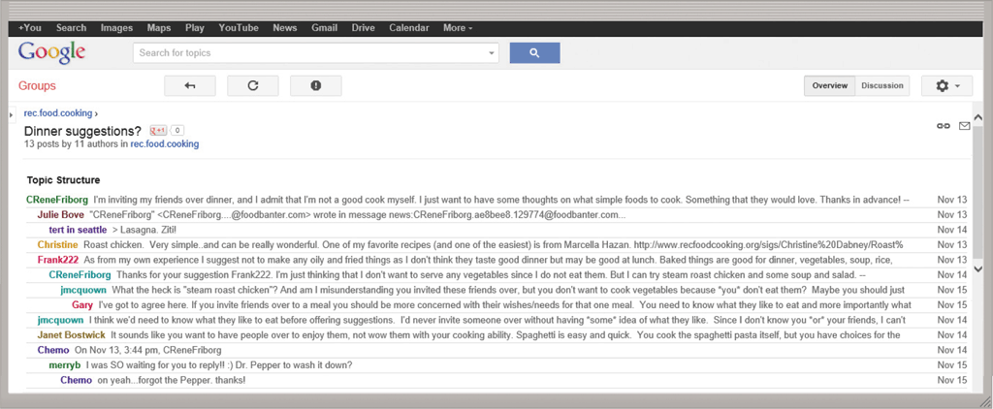
Other Internet Services
An online discussion is an online area in which users have written discussions about a particular subject
Page 91
Figure 2-30

Slide 40
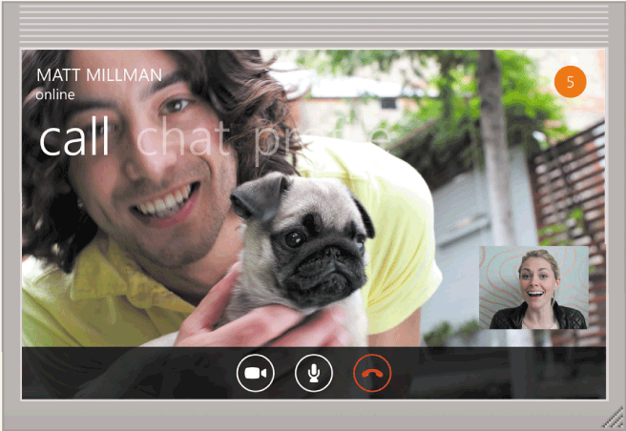
Other Internet Services
VoIP (Voice over IP) enables users to speak to other users via their Internet connection
Page 92

Slide 41
Other Internet Services
FTP (File Transfer Protocol) is an Internet standard that permits file uploading and downloading to and from other computers on the Internet
Many operating systems include FTP capabilities
An FTP server is a computer that allows users to upload and/or download files using FTP
Page 92

Slide 42
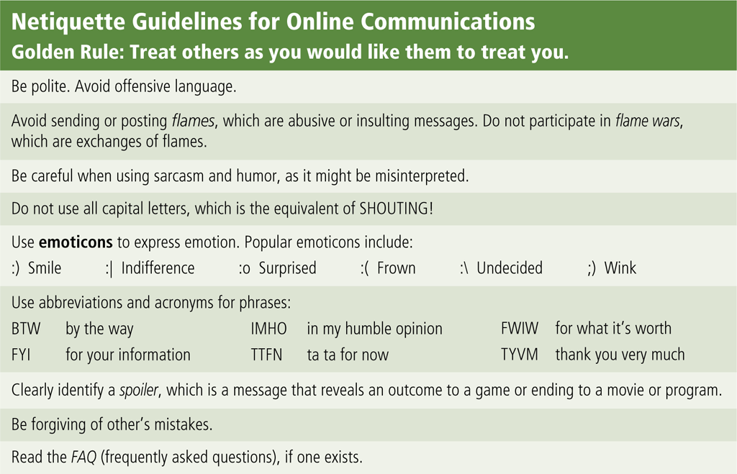
Netiquette
Netiquette is the code of acceptable Internet behavior
Page 94
Figure 2-31

Slide 43
Chapter Summary
Evolution of the Internet
The web
Various types of websites and media
Other services available on the Internet
Netiquette
Page 95

